Slide 1
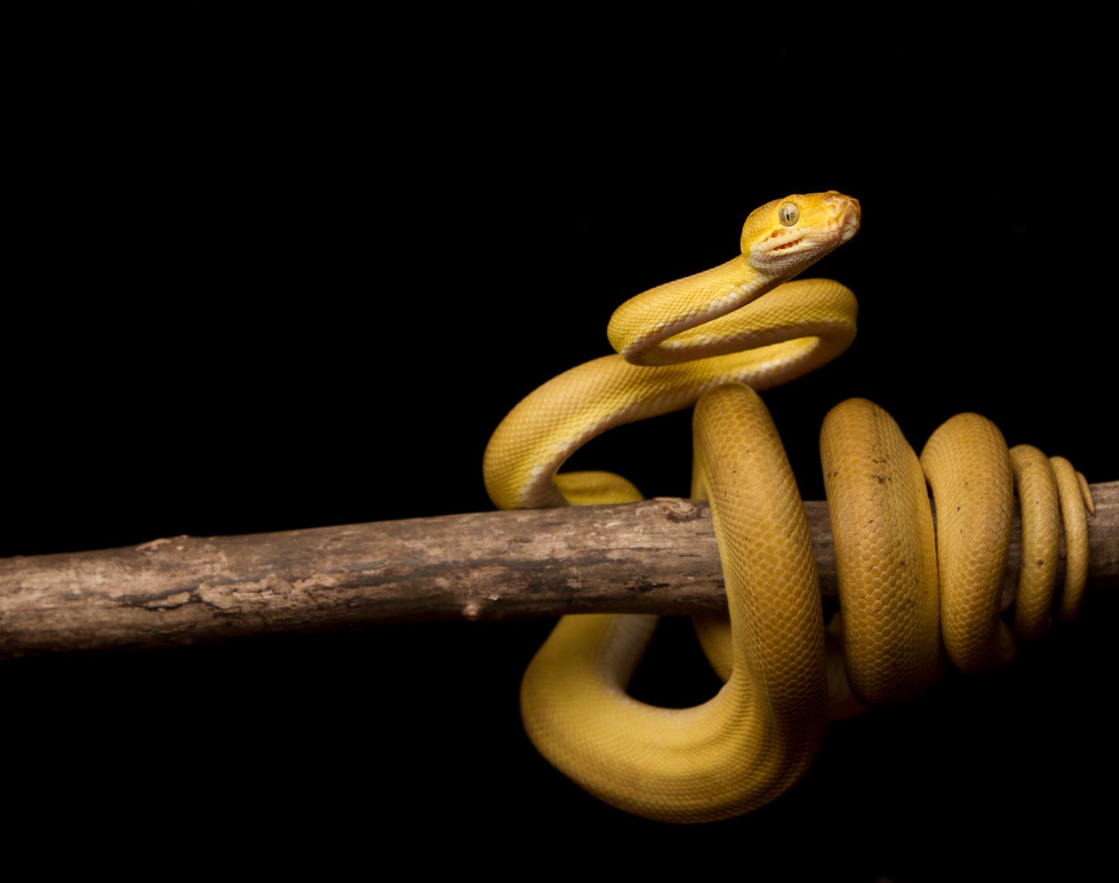
Session 1: Python Basic Exercises
Solve these questions and test yourself!
Happy Learning!

Slide 2
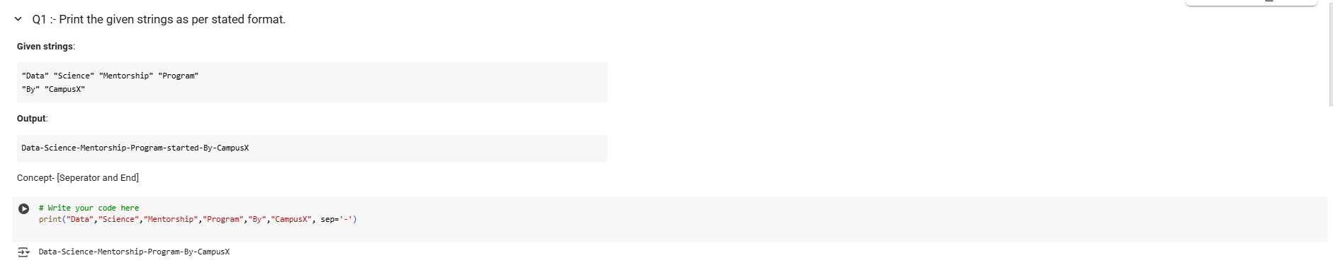
Print Strings in Format
Q1: Printing Strings with a Separator

Slide 3
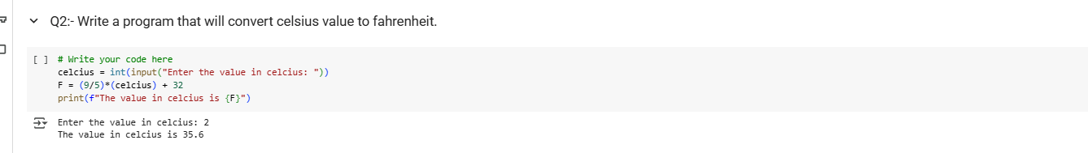
Celsius to Fahrenheit
Q2: Celsius to Fahrenheit Converter
Formula:
𝐹=(9/5×Celsius)+32

Slide 4
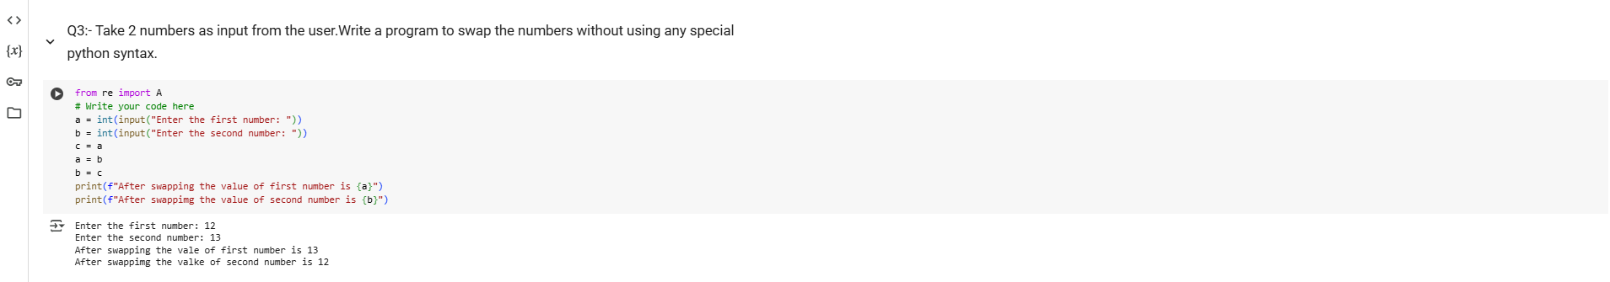
Swap Two Numbers
Q3: Swap Numbers without Special Syntax

Slide 5
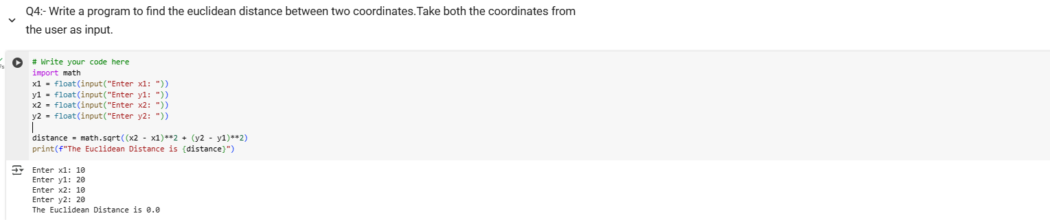
Euclidean Distance
Q4: Find Euclidean Distance
Point 1: Euclidean distance measures the shortest straight-line distance between two points in a 2D plane.
Point 2: It is widely used in fields like Machine Learning (K-Nearest Neighbors), Computer Vision, and Geometry.

Slide 6
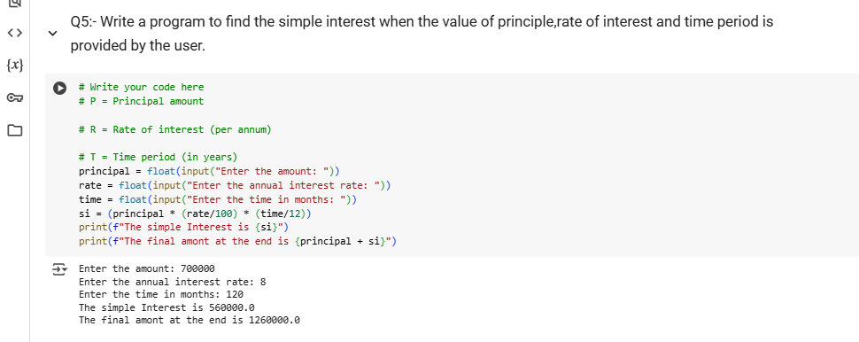
Simple Interest Calculator
Q5: Find Simple Interest

Slide 7
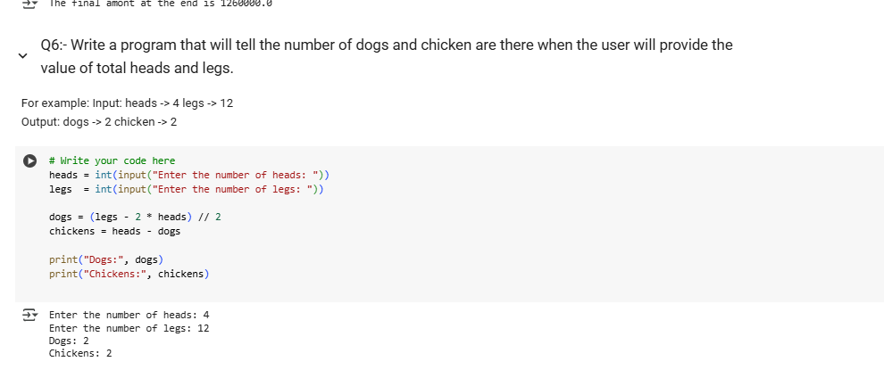
Q6 - Heads and Legs Problem
Title: Q6: Find Dogs and Chickens
Condition:
Solve based on:
Heads = total animals
Legs = 2 for chicken, 4 for dog

Slide 8
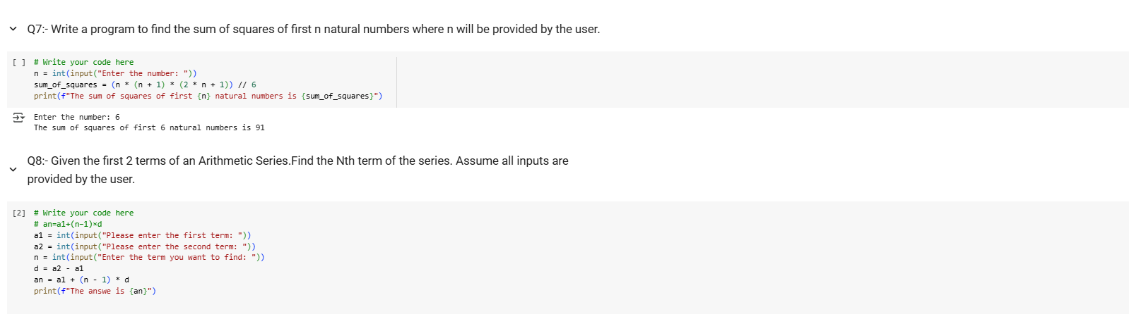
Sum of Squares
Q7: Sum of Squares of N Natural Numbers
Q8: Find Nth Term

Slide 9
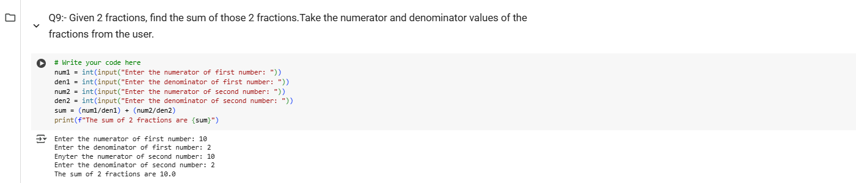
Sum of Two Fractions
Q9:- Given 2 fractions, find the sum of those 2 fractions . Take the numerator and denominator values of the fractions from the user.

Slide 10
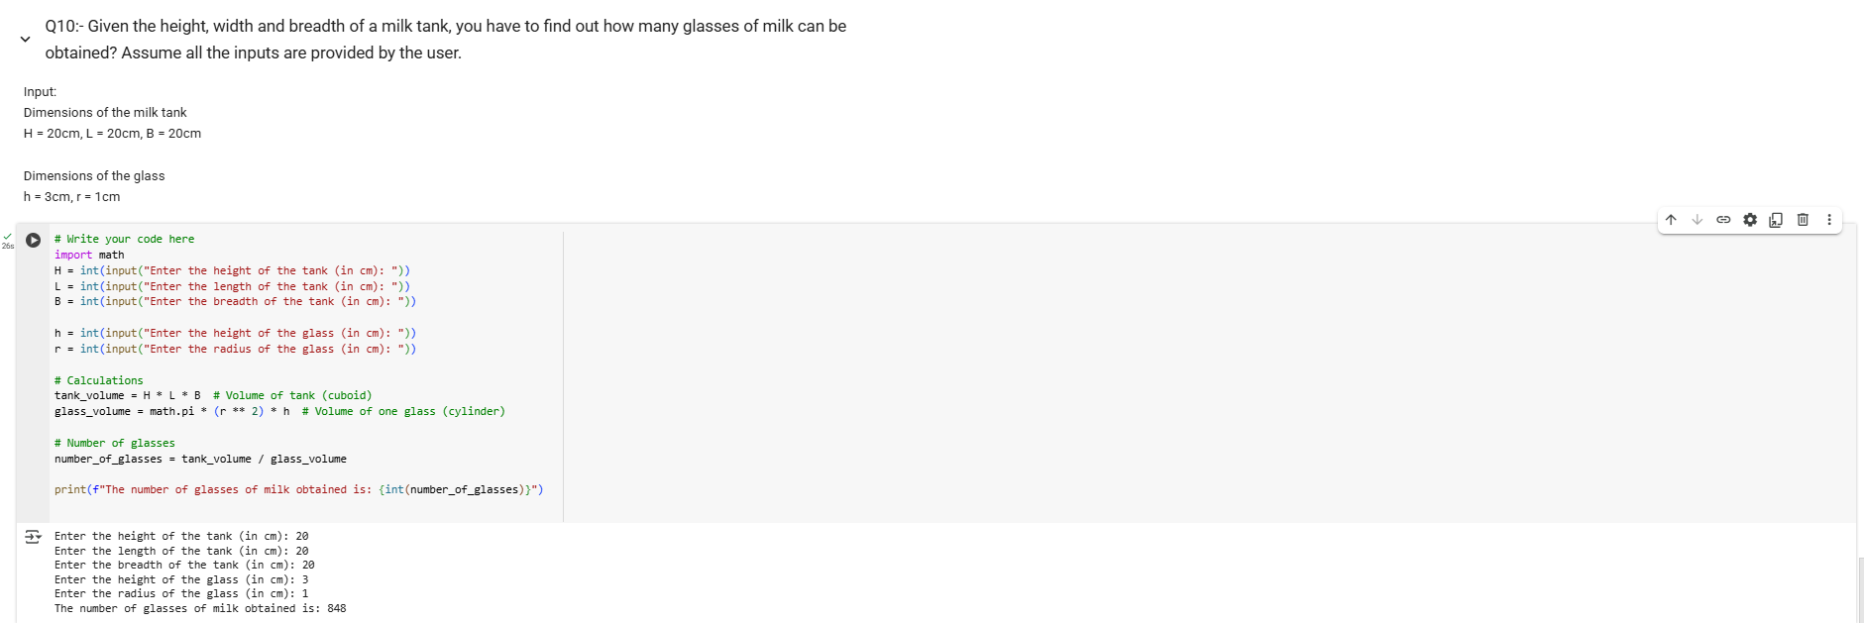
Number of Glasses
Q10:- Given the height, width and breadth of a milk tank, you have to find out how many glasses of milk can be obtained? Assume all the inputs are provided by the user.

